Slide 1

To insert your company logo on this slide
From the Insert Menu
Select “Picture”
Locate your logo file
Click OK
To resize the logo
Click anywhere inside the logo. The boxes that appear outside the logo are known as “resize handles.”
Use these to resize the object.
If you hold down the shift key before using the resize handles, you will maintain the proportions of the object you wish to resize.
Enron Finland Energy
&
Vneshtopprom Exposure Analysis
Confidential/Attorney Client Privilege

Slide 2
Table of Contents
Background Pages 3-4
Altered Bills of Lading Pages 5-6
Exposure Pages 7-8
What Went Wrong? Page 9
Next Steps Page 10
Revised Helsinki Business Model Pages 11-12

Slide 3
Background to Greenergy Transaction
Enron purchased a portfolio of 12 Russian oil products contracts from Greenergy, some with a pre-financing component (e.g. Vneshtopprom), in August of 1998
Purchase Price total: $8,000,000 ($4mm up front, 4 quarterly $1mm payments), fully amortized by September 1999
Six employees hired by Enron, two-year employment agreements signed by three commercial personnel
Notes:
##
*
*
07/16/96

Slide 4
Background to Current Exposure
Helsinki entered into fixed price transactions with Vneshtopprom and London put on financial hedges against that fixed price exposure (Contracts dated April 30th, May 5th, June 8th)
Prepayments were made against these fixed price contracts as well as contracts agreed on a floating price basis
Export Ban on Russian fuel oil deliveries effective September 99
Deliveries were not up to contractual volume, and undelivered volume was rolled forward as were the financial hedges against that volume
Market prices increased greatly over the time period May 99 to October 99
Inquiry began in late October 1999, when Finland trader called London trader asking her to roll large financial hedge position “quietly”
In November 99, senior Europe management prohibited new prepayments and charged commercial head of trading with negotiation and recovery of both the mark to market and prepayment exposure
During negotiations in January 2000, Vneshtopprom made accusations that Helsinki had altered delivery documentation [Bills of Lading] and disputed the amount owed

Slide 5
Altered Bills of Lading
Altered Bill of Lading activity had been discovered in February 99 by Kevin Sweeney, and communicated to Kevin Beasley, David Mally, and Graham Cane
Orders were issued to cease any activity of that kind to Helsinki commercial and support staff
Senior Europe management were unaware of this when they reviewed the Vneshtopprom situation in November 99
Vneshtopprom claimed that of a total of 80 movements, 60 had been altered
22 of the altered documents related to the period April 99 through July 99
Using a typewriter ribbon, Enron has been able to validate that 20 of these were typed or altered in the office
There were a total of 22 entries on the ribbon for the period of April through July, therefore only 2 or 10% possibly relate to other counterparties
Notes:
##
*
*
07/16/96

Slide 6
Calculation of Counterparty Claim Exposure
Vneshtopprom:
75% of 500,000 Metric Tons may have involved altered Bills of Lading
Our investigations indicate the value of a potential claim at $1,500,000
This is equivalent to $4 per Metric Ton
Vneshtopprom indicated an amount of circa $900,000
Other Pre-finance Counterparties:
Estimated to be 10% fraudulent activity associated with other counterparty volume
Other counterparty volume is approximately 4,200,000 Metric Tons
$2-$5 per Metric Tons gained from fraudulent activity
Potential Claim of $840,000 to $2,100,000
Notes:
##
*
*
07/16/96

Slide 7
Exposure Analysis - 12/31/99
(In USD million)
Vneshtopprom Maximum Exposure Expected Loss
  Outstanding Pre Financing Balance 4.3 0.0
  Gross MTM recognised on fixed price deals 11.9 [5.0]
  Gross Exposure 16.2 [5.0]
  Less Balance written off in November and December 1999 (2.5) (2.5)
  Total Remaining Vneshtopprom Exposure 13.7* [2.5]*
Other Potential Exposure Items - (Maximum Impact)
  Take or Pay Storage Commitment 9.3** 3.1**
  Severance Payments 0.5 0.0
  Office Closure Costs (Lease expense, IT infrastructure) 1.3*** 0.0***
  Unidentified Counterparty Claims 2.1 [1.4]
TOTAL EXPOSURE 26.9 [7.0]
* Provisions of $9.5 existed at 12/31/99, balance has been provided for in Q1 2000
** Current market quotes indicate a rate at or above the contract rate; sub leasing currently being investigated
*** The office could be utilized by EES and power trading if oil trading was relocated
Notes:
##
*
*
07/16/96

Slide 8
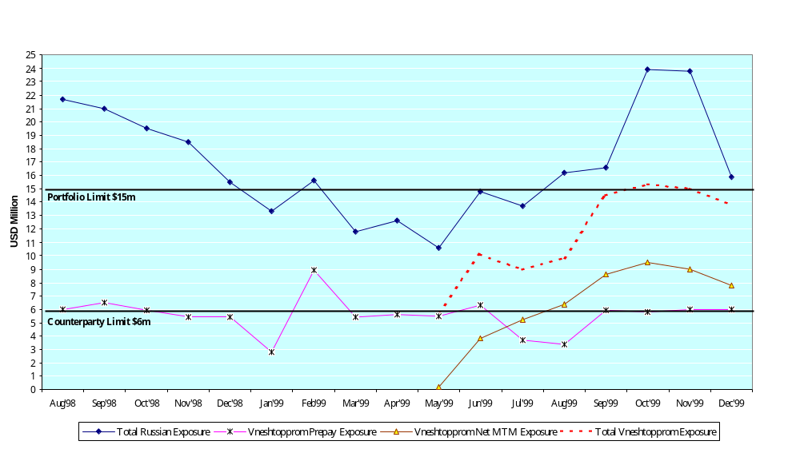
Russian Credit Exposure
Notes:
##
*
*
07/16/96

Slide 9
What Went Wrong?
Over reliance on key commercial individuals
  Lack of seasoned Enron commercial and support staff in Helsinki
  Head of Helsinki trading group able to exert undue influence on controls
  London head of trading group was also key stakeholder in origination effort
  Selective communication of facts by key commercial individuals
Due diligence highlighting material absence of information not referred to in DASH and no formal process for review before changing risk profile
Acknowledgement of confirmations and amendments to confirmations/contracts not obtained from pre-finance counterparties (e.g. on rolling forward of undelivered volume)
Lack of appropriate follow-up on Bill of Lading issue after detection in Feb/Mar 99
Prepayment and MTM exposures were not aggregated for management reporting of credit exposure
No formal process for reporting credit exposure limit violations
Volumetric and Valuation reconciliation was not done on a timely basis
Telephone lines in office were not recorded
Notes:
##
*
*
07/16/96

Slide 10
Next Steps
  Pursue negotiations with Vneshtopprom for settlement of outstanding amounts
  Implement revised Helsinki Office business model (see next slides)
  Consider implications of lessons learned
Notes:
##
*
*
07/16/96

Slide 11
Helsinki Office Revised Business Model
Commercial Changes
Business Scope
  No prepay transactions (Already in place)
  Origination of product only upon the request of UK traders (Already in place)
Business Management Activities
  Activity will be managed by a London import (Chris Mahoney), reporting to John Nowlan
  All transactions to be approved by John Nowlan or his designee
  Regular on-site oversight by John Nowlan and Goran Novakovic

Slide 12
Helsinki Office Revised Business Model
Operational Changes
Business Management
  Logistics managed by London import to Helsinki (Graham Cane)
  Senior London operational controller imported to Helsinki (Richard Sage) (January 31, 2000)
  Risk Management Administration/Accounting overseen by London import to Helsinki (Paul Wallace) (Already in place)
  Senior accounting personnel from London to work in Helsinki for month end close each month
Business Process
  Add recorded lines for originators and logistics (in current office if feasible, otherwise in new office)
  Procedure manual for Helsinki business to be prepared and reviewed with all Helsinki and London Global Products personnel
  Confirmation to be reconciled to risk book prior to being sent to counterparties; form of confirmation to be reviewed by Legal
  Document retention procedures to be created, with a complete set of all documents to be retained in London and Helsinki
  Settlements processes to be reviewed and revised to provide additional controls

